Slide 1
Business Support Service
Board Report
Presented by:
Assistant Superintendent for Business Support Services
July 21, 2021

Slide 2
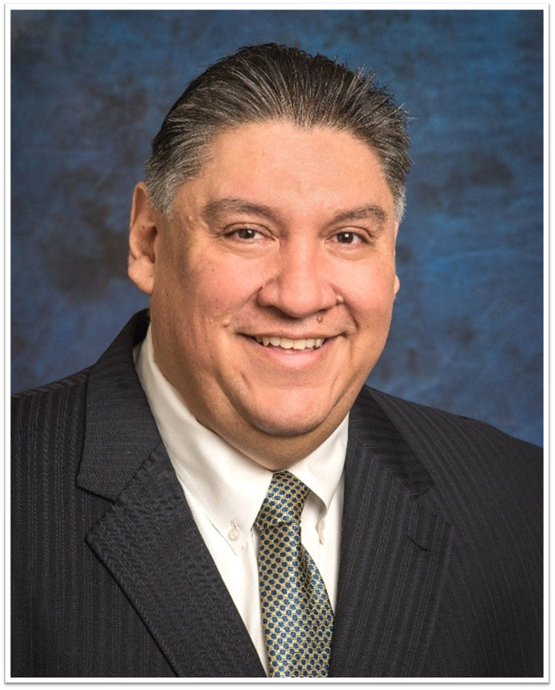
Jesus J. Amezcua, Ph. D., CPA, RTSBA
Assistant Superintendent
for Business Support Services

Slide 3
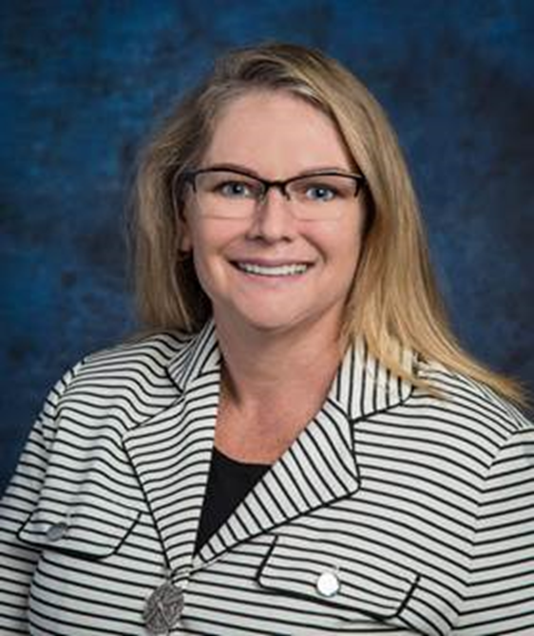
Stephanie Barnett
Chief Accounting Officer

Slide 4
Business Services is committed to
financial transparency and providing excellent customer service to all stakeholders. We are responsible for timely and accurate reporting of accounting, accounts payable, payroll, budget, accounts receivable, fixed assets, debt management, investments and grants management. We also manager the Educations Foundation and the Public Finance Corporation records.
Executive Summary

Slide 5
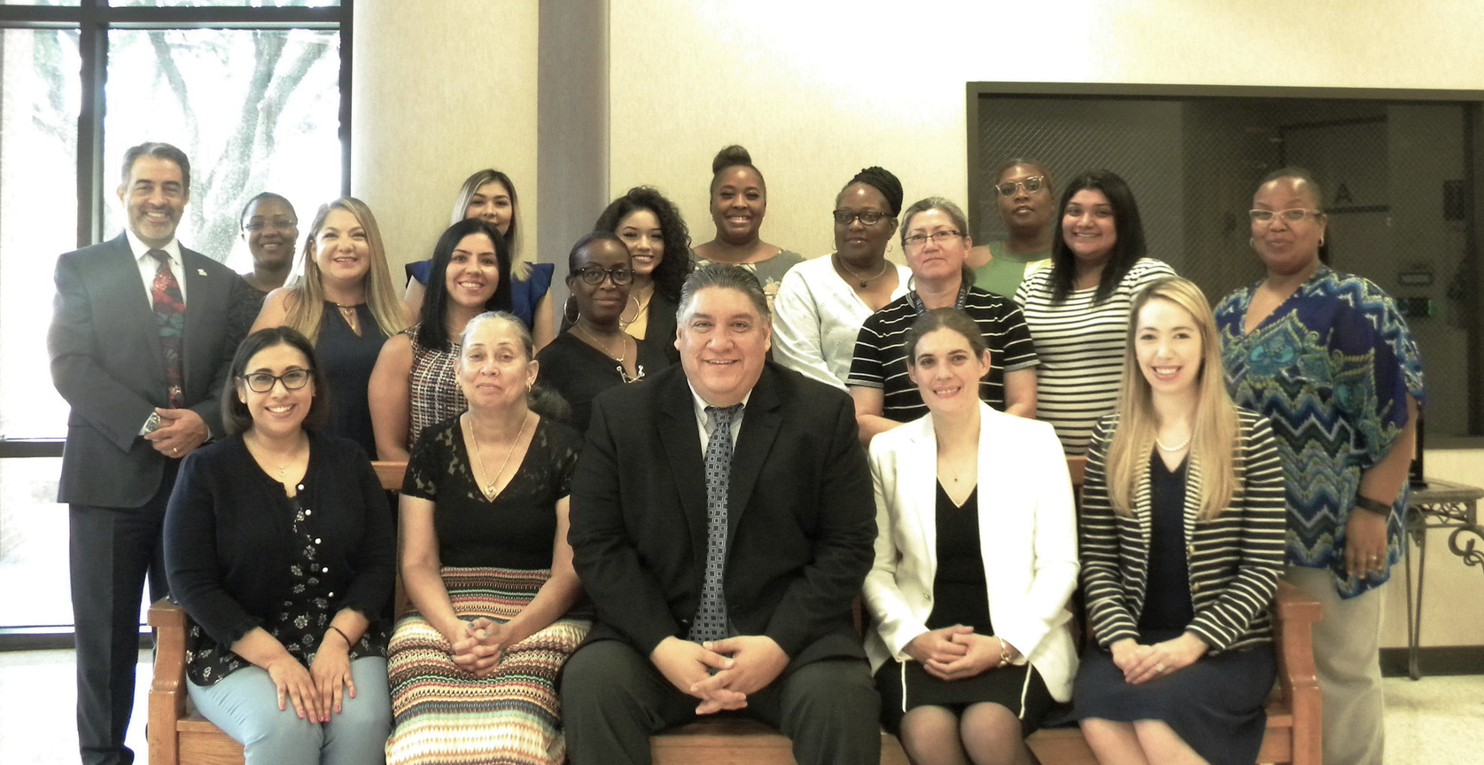
Business Services Staff
Pictured from left to right
Front Row: Jessica Bermea, Priscilla Hines, Dr. Jesus Amezcua, Marcia Leiva, and Stephanie Ritchie.
Back Row: Jaime Martinez, Natalya Sumner, Diana Garcia, Rubi Platero, Cynthia Goodwin, Lynette Adams, Laboria ,Shequaia Harris, Katina Washington, Ana Munoz, Yolanda Davis, Desirae Deleon and Brandy Bullock.

Slide 6
Functions of Business Services
Provide accurately and timely financial information to internal and external customers.
Process vendor payments accurately and timely.
Continue receiving prestigious financial awards for the annual financial report, budget report, investment policies and financial transparency.
Safeguard our assets and investments.
Process payroll accurately and timely.
Automate more work flows to become more efficient and effective.
Maximize receivable collections.

Slide 7
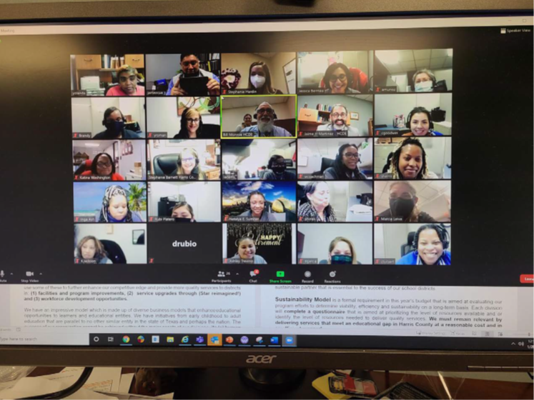
Implemented the adobe sign software which allowed for approvals and signatures on lines for all invoices, AP batches, contracts,P.O. change orders, accounts receivable adjustment and many other forms.
Implemented the appddiction app which allowed payments authorization approval online with supporting documentation.
New
Online
Processes
COVID19 pandemic allowed us new opportunities to enhance our processes; Staff worked diligently from home and continued to process payroll, accounts payable vendor payment and daily transactions timely.

Slide 8
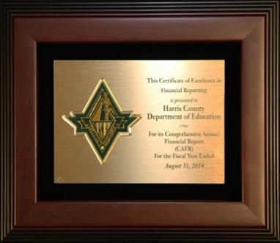
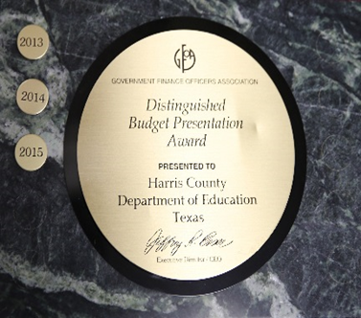
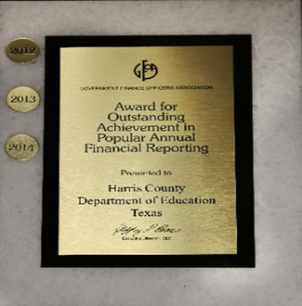
Business Services Awards
CAFR
BUDGET
PAFR
GFOA & ASBO AWARD-18 & 16 CONSECUTIVE YEARS
GFOA & ASBO AWARD-11 CONSECUTIVE YEARS
GFOA AWARD-12 CONSECUTIVE YEARS

Slide 9
Business Services Awards
Received three stars from the Texas Comptroller’s Office on Transparency regarding traditional finances, debt and purchasing.
Received the Certification from the Government Treasurer’s Association of Texas (GTOT) for the investment policy.
The Pinnacle Award recognizes school business professionals for their resourcefulness and creativity in solving the challenges that school districts face today.
This is the first time HCDE has received the award.

Slide 10
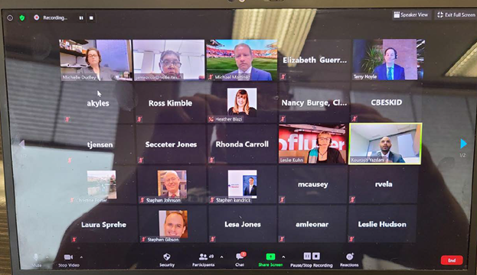
The School Finance Council is a program that hosts regular support and best practices meetings for school district business managers and chief financial officers.
Topics include legislative updates, bond issuance, economic analysis, investment trainings, EDGAR, COVID19 and ethics classes. Guest speakers from TEA, IRS, Comptroller’s Office, Federal Reserve and other entities regularly participated in the zoom meetings to make presentations.
The School Finance Council meets monthly with over 648 participants from 25 school districts and charter schools. Offering these meeting via zoom increased participation by 19% as compared to prior years.
The School Finance Council has partnered with Texas Association for School Business Officials (TASBO) to provide continuing certification credits.

Slide 11
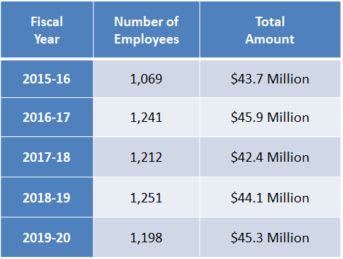
Operating Measures
Payroll processes checks the 15th and last day of the month. Utilizes adobe sign for all timesheets, forms and documents.
Accounts Payable processes checks every Friday. Utilizes adobe sign for all invoices, forms and documents.
Fiscal Year | Number of Transactions | Total Amount
2015-16 | 10,494 | $20,930,478
2016-17 | 10,524 | $16,913,630
2017-18 | 10,623 | $17,073,433
2018-19 | 9,469 | $18,521,157
2019-20 | 7,502 | $14,485,066
PR processed 1,162 IRS-W2 forms
totaling $39M of taxable wages.
AP processed 148 IRS-1099NEC forms totaling $5.3M
and 3 IRS-1099 MISC totaling $836,995.

Slide 12
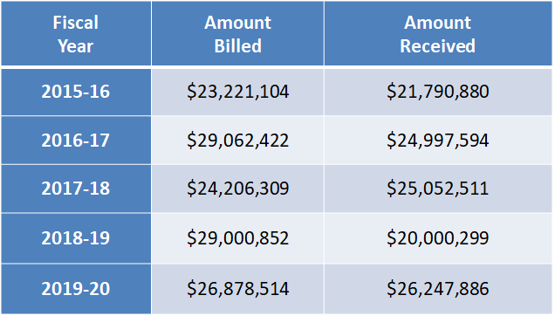
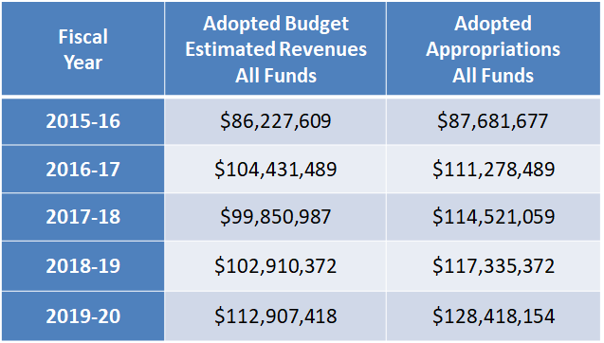
Operating Measures
Accounts Receivable process invoices monthly. Utilizes adobe sign for all invoice adjustment, voids and refunds.
Budget cycle is year-round. Budget reviews are in April. Final approval in July. Utilizes adobe sign for documents.
AR processes invoices for 10 different divisions.
There were over 930 budget amendment/transfers processed

Slide 13
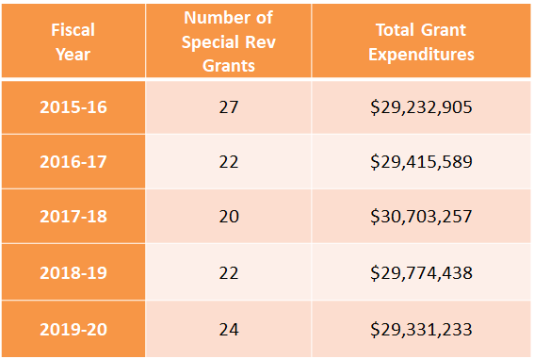
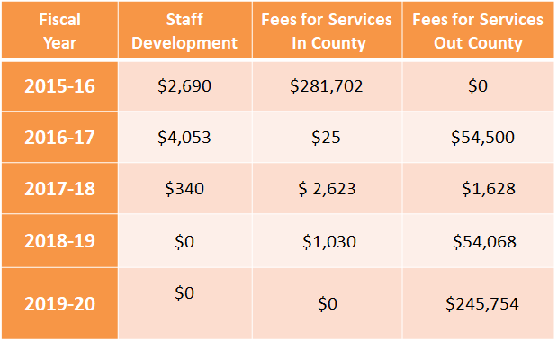
Operating Measures
Accounting manages 27 funds ranging from $500 to $12.7 Million. Utilizes adobe sign for grant drawdown and quarterly certifications forms.
HCDE Plus provides services to ISDs and Charters which generates revenues. Utilizes adobe sign for contracts.
Processed over 2,730 journal entries
totaling $172.9M
Services provided to Stafford MSD and Pearland ISD and Beeville ISD

Slide 14
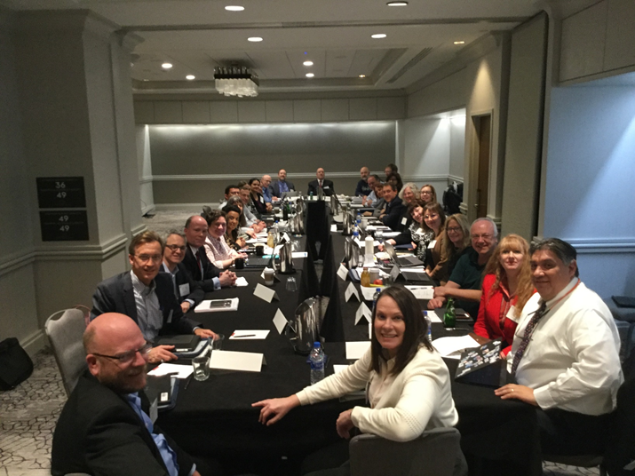
Other Division Highlights
•EDGAR Class and Webinar
•Participated as a REAL SuperMENtor where Dr. Amezcua and Jaime Martinez read to children at a Head Start center via zoom
•Dr. Amezcua is on the Education Committee for the Rotary Club and Adoption Fair held at HCDE
•Taught financial courses at Principal and Superintendent Academy
•Taught EDGAR rules to other school district staff
•Taught several financial courses to City of Houston employees
•Dr. Amezcua also participated in TASBO committees
•Best Practice Committee-Texas Certified Public Accountants
•Best Practice Committee-GFOA and ASBO

Slide 15
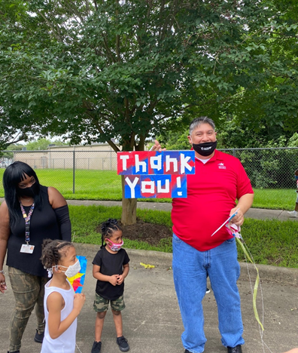
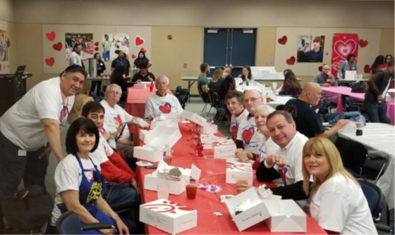
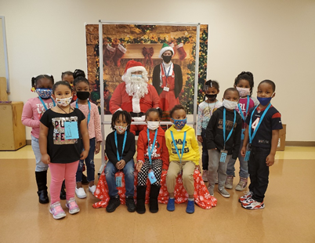
Community Involvement
Business Support Services supports our community by participating in difference events such as:
•Christmas toy drive and Santa’s visit for Head Start students
•Thanksgiving basket-Head Start family
•SuperMENtor reading program vis zoom
•Rotary Club Adoption Fair
•City of Houston Trainings

Slide 16
For 2020 and due to the COVID19 pandemic the FOG training documents were posted on the HCDE portal. Department videos were also posted for quick reference. Zoom one-on-one training is also provided upon division’s request. The Financial Operating Guidelines is available in the HCDE website and the Business Services and Purchasing internal portals.
Financial Operating Guidelines

Slide 17
For more information about this HCDE Business Division Annual Board Report, contact:
Jesus J. Amezcua, RTSBA, CPA, Ph.D.
Assistant Superintendent for Business Services
Email: jamezcua@hcde-texas.org

